Slide 1
Precision Agriculture Monitoring Quadruped Robot Dog
PROJECT I — PRE-FINAL REVIEW
A 12-DOF printed quadruped with a distributed field-sensing payload: an ESP32-S3 sensor node, an ESP32-CAM camera node and leaf-disease classification on the laptop, with locomotion validated in MuJoCo physics simulation.
Presented by:
Adithya Sankar Menon (23BRS1079)
Siddhesh Pushkraj Shinde (23BCE5048)
Rachit Gupta (23BCE1658)
Guide: Dr. Lakshmanan K (54758)
Notes:
Introduce the team and the one-line summary: the robot platform is printed, the sensing payload is built and working end to end, and locomotion is validated in a physics simulator. The live demo follows the results.

Slide 2
Problem Statement
Field monitoring relies on manual scouting or drones; neither gives close-range, multi-parameter readings at crop level.
Wheeled and tracked rovers struggle in mud, soft soil and the narrow furrows between planted rows.
Disease is often noticed only once it is visible across the field, when treatment is costly.
Commercial agricultural robots remain too expensive for most small and medium farms.
20–40 %
of global crop production is lost to plant pests and diseases every year (FAO).
Notes:
Frame the gap: monitoring at crop level needs close-range sensing, and the platforms that can get there are either expensive or struggle on farm terrain. The FAO figure is the motivation for early detection.

Slide 3
Project Objectives
Mobility
Sensing
A low-cost 3D-printed 12-DOF quadruped whose gait is validated in physics simulation against real servo torque limits.
Close-range gas (TVOC, eCO₂), dust, temperature and distance sensing carried on the chassis.
Plant-health AI
Live dashboard
Camera-based leaf-disease classification that first checks whether a leaf is in view at all.
A wireless dashboard that logs every reading and tags each leaf image with the air conditions at capture time.
Notes:
Four objectives, each of which maps to a demonstrable module later in the deck.

Slide 4
Design Revision Since Review III
The sensing payload moved off the Jetson onto two ESP32 nodes; locomotion moved to a physics simulator plus an MVP build.
Review III plan | Built now | Reason
Jetson Orin Nano on the robot | XIAO ESP32-S3 + ESP32-CAM nodes; inference on the laptop | A fall risks an expensive board; MG996R torque margin is thin; inference needs no onboard GPU
IMX219 CSI camera | ESP32-CAM (OV3660), Wi-Fi MJPEG stream | The ESP32-S3 has no MIPI-CSI camera interface
ROS 2 + MQTT on board | Flask dashboard over the laptop hotspot | Fewer moving parts; every device on one local network
Gazebo dynamics model | MuJoCo physics simulation | The Gazebo stance never stabilised; MuJoCo walks and reports metrics headless
Walking trials on hardware | Simulation results now; servo MVP next | Torque analysis showed walking needs CoM-centred footholds first
Notes:
Be direct about the changes and the reasons. The scope was narrowed to what could be built and tested in the time available; locomotion is validated in simulation and continues as an MVP build.

Slide 5
System Architecture
Sensor node
Laptop · 192.168.137.1
Camera node
XIAO ESP32-S3 + expansion board
SGP30 gas · I²C 0x58
MCP9808 temp · I²C 0x18
PPD42 dust · D0
HC-SR04 × 2 · D6–D9
OLED, buzzer, button
Wi-Fi hotspot, 2.4 GHz
Flask dashboard :5000
CSV log of every reading
MobileNetV2 + leaf check
Video relay to all viewers
ESP32-CAM, OV3660 sensor
MJPEG video on :81
Single photo on :80/capture
Registers itself at boot
JSON every 5 s →
← MJPEG video, ~16–20 fps
Platform SpotMicro-based printed chassis carrying both nodes · 12 × MG996R servos (stand-and-step MVP) · gait and torque limits validated in MuJoCo
Any phone on the hotspot can open the dashboard at http://192.168.137.1:5000
Notes:
Walk the data path left to right: the sensor node posts JSON every five seconds, the camera streams MJPEG, the laptop runs the dashboard, the logger and the classifier. All three sit on the laptop's Wi-Fi hotspot.

Slide 6
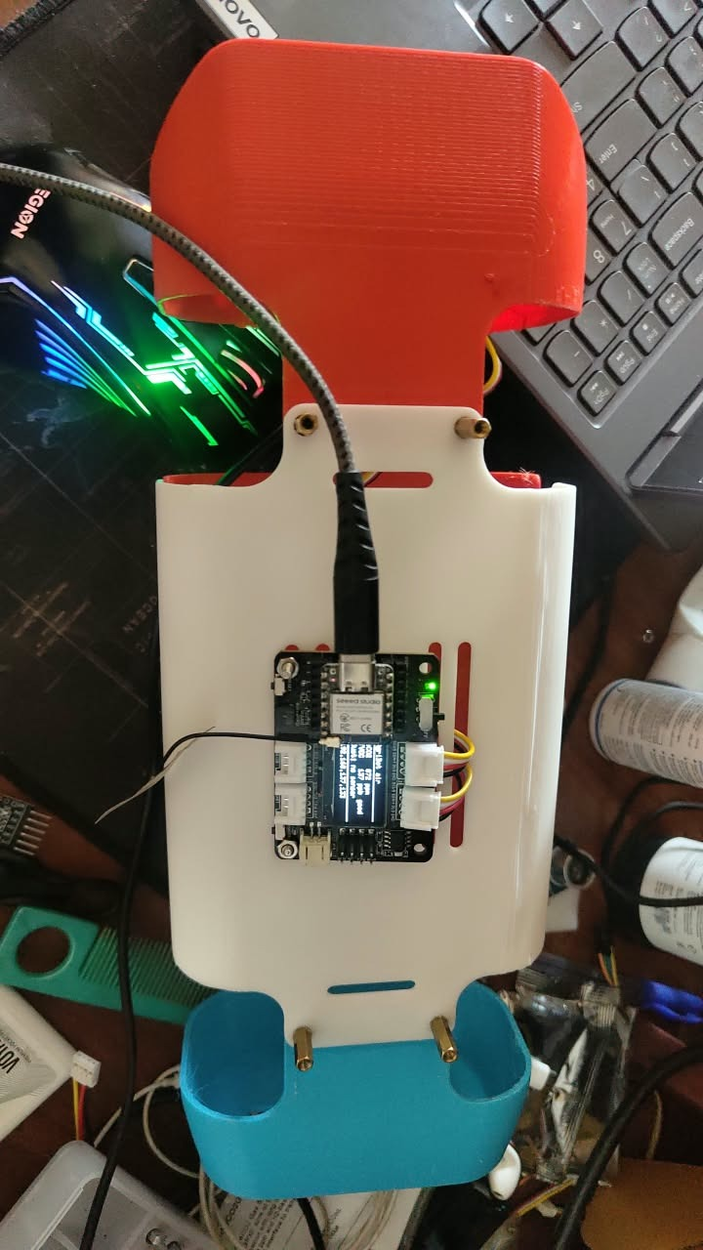
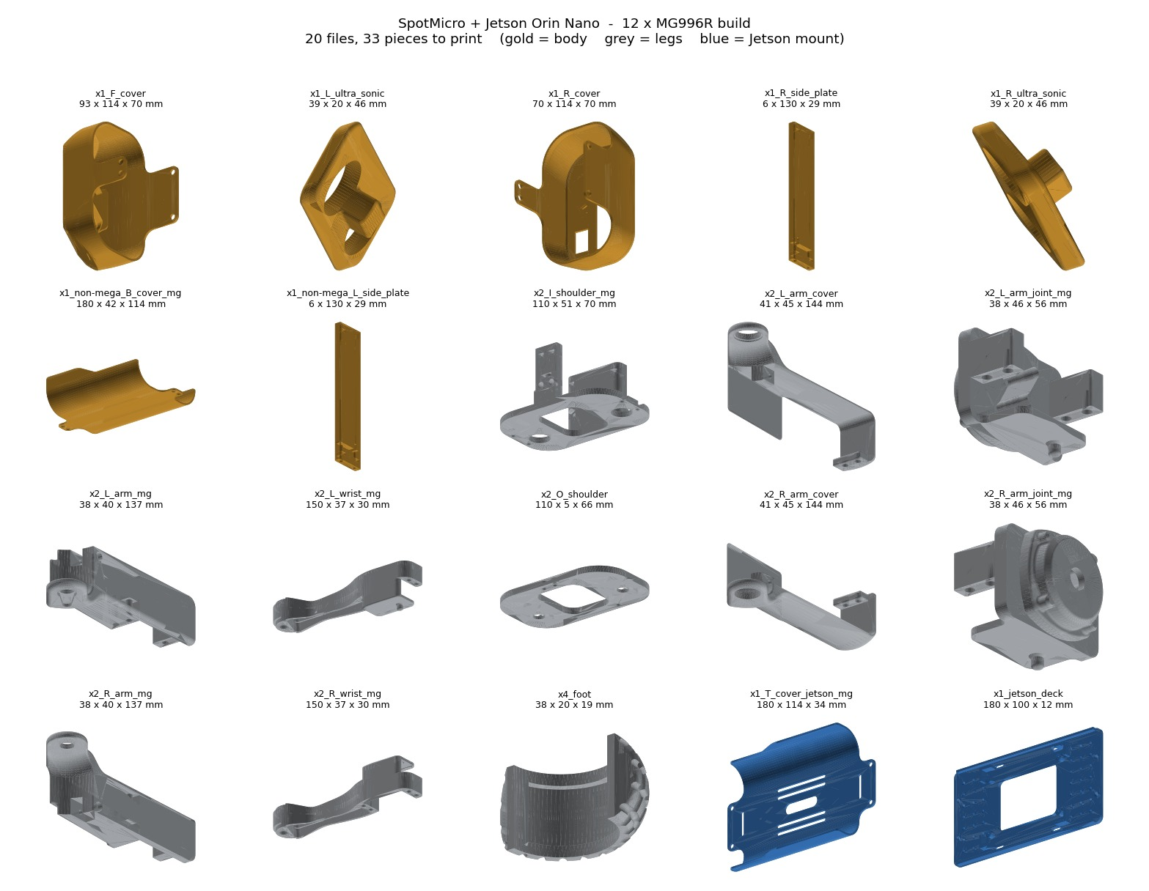
Mechanical Build — Printed Chassis
35 parts printed and verified; base design SpotMicro (KDY0523, CC-BY), adapted for our payload
~700 g PLA+ structure, TPU foot pads · printing cost ₹5,200
Geometry measured from the prints: hip spacing 140 × 78 mm, femur 111 mm, tibia 125 mm
Four team-designed parts: top cover, sensor deck, PPD42 and SGP30 brackets
Sensor node now mounted on the printed top cover (photo)
Print set (left) · sensor node on the top cover (right)
Notes:
The chassis is SpotMicro adapted for our payload; geometry was measured from the printed parts. The sensor node is already mounted on the printed top cover, shown in the photo.

Slide 7
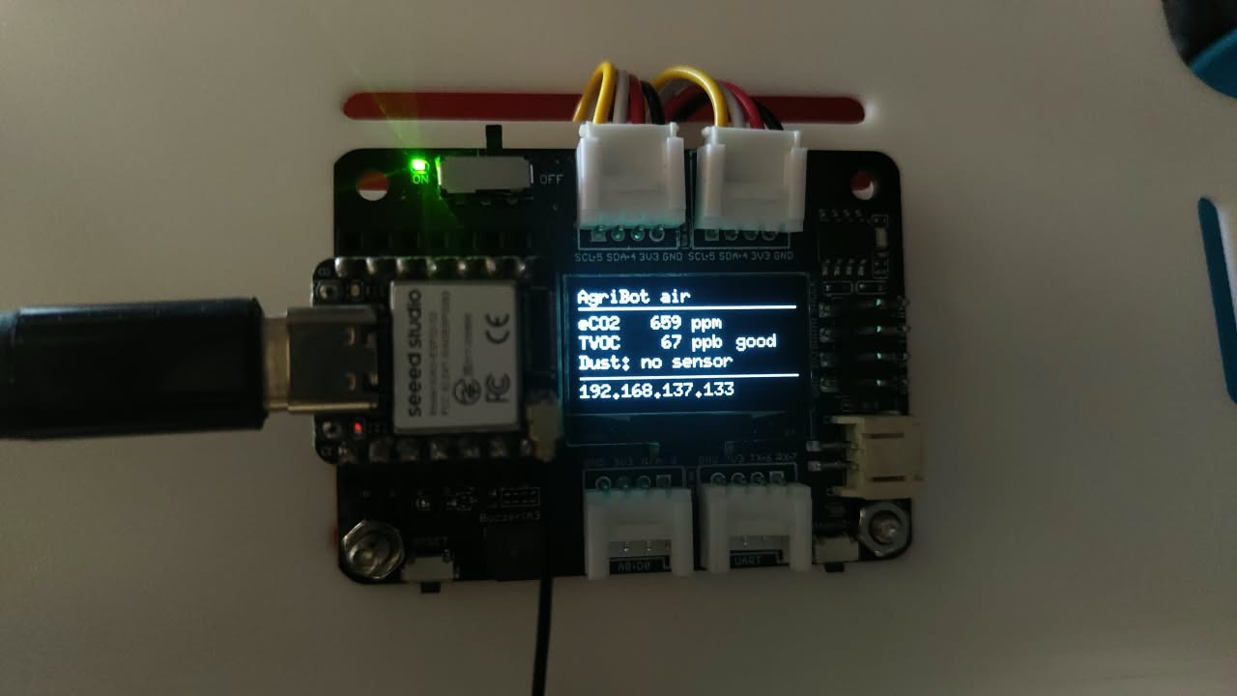
Sensor Node Hardware
Sensor | Measures | Interface | Status
SGP30 | TVOC, eCO₂ | I²C 0x58, Grove IIC 1 | Live
MCP9808 | Temperature ±0.25 °C | I²C 0x18, Grove IIC 2 | Live
OLED, buzzer | Local display, alerts | On board | Live
PPD42 | Particles > 1 µm | D0 via divider | Wiring pending
HC-SR04 #1 | Obstacle / row end | D6 trig, D7 echo | Wiring pending
HC-SR04 #2 | Canopy height | D8 trig, D9 echo | Wiring pending
Live readings and IP address on the node's OLED
Every 5 V sensor output reaches the 3.3 V XIAO through a 1 kΩ / 2 kΩ divider: 5 V → 3.3 V, and the PPD42's 4 V → 2.7 V.
Firmware for the three pending sensors is written, compiled and uploaded; they report as absent until connected.
Notes:
The XIAO ESP32-S3 on its expansion board: two Grove I2C sensors live now, three more with firmware complete and wiring pending. Point out the divider rule.

Slide 8
Firmware Engineering
Interrupt-timed dust
Missing-sensor detection
Temperature-corrected range
PPD42 low-pulse time is accumulated in an interrupt over 30 s windows, so sampling never blocks the loop.
An unplugged PPD42 read as 1,114,001 particles and sounded the alarm. A line held low with no pulses is now reported as absent.
Speed of sound from the MCP9808: c = 331.3 + 0.606·T m/s. Fixed 343 m/s is ~3 % off at 35 °C.
Crosstalk-free ultrasonics
Wi-Fi diagnostics
Self-registering camera
The two HC-SR04s fire alternately, never together, and each reading is median-of-3 filtered.
Reports why a connection fails. It traced a −78 dBm link to a missing antenna; fitted, the link reads −26 dBm.
The ESP32-CAM sends its photo and stream URLs to the dashboard at boot, so a new IP address needs no setup.
Notes:
Each card is a decision that came from testing. Two of them, the missing-sensor detection and the Wi-Fi diagnostics, fixed real faults found on the bench.

Slide 9
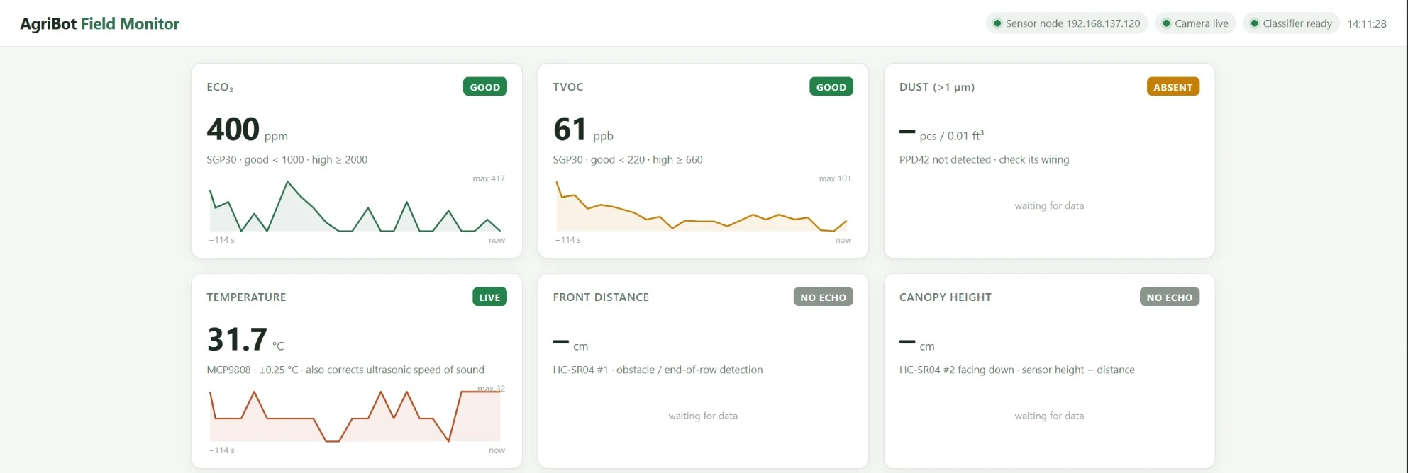
Live Dashboard
Status bands TVOC per the German UBA guideline (220 / 660 ppb), eCO₂ 1,000 / 2,000 ppm
Logging every reading to a daily CSV · 10-minute charts · no internet needed at runtime
Notes:
Show the dashboard live after this slide. Each card has a good / moderate / high band; every reading is logged to CSV; any phone on the hotspot can view it.

Slide 10
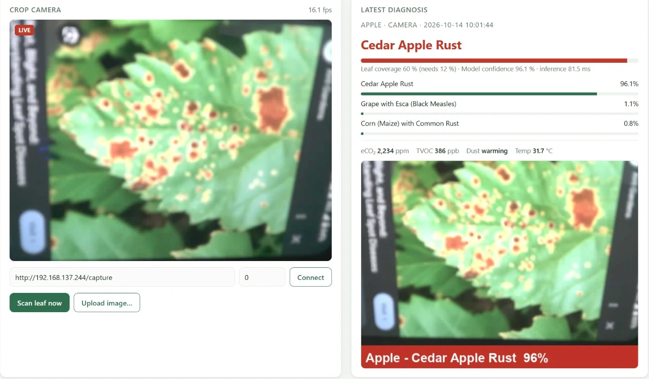
Leaf-Disease Classification
1 Frame from the ESP32-CAM stream
2 Leaf check: ≥ 12 % of pixels leaf-coloured (hue 38–165°, saturation ≥ 0.2)
3 MobileNetV2, PlantVillage: 38 classes, 14 crops
4 Below 50 % confidence → reported as uncertain
5 Image saved, tagged with crop, condition, gas and temperature
Input | Result
Room, no leaf | Rejected (0–0.1 % coverage). Model alone: “Citrus Greening 82–90 %”
12 PlantVillage leaves | All accepted (27–76 % coverage)
Inference | 30–80 ms per image on the laptop CPU
Live scan through the ESP32-CAM: Cedar Apple Rust, 96 %, leaf coverage 60 %
Notes:
The model alone has no 'not a leaf' answer: pointed at the room it said Citrus Greening with 82-90 % confidence. The leaf check runs first and rejects those frames. Demonstrate both cases live.

Slide 11
Results — Hardware Validation
Every working module was exercised on the bench; all values are from those runs.
Test | Result | What it shows
SGP30, breath test | eCO₂ 400 → 746 ppm, TVOC 0 → 210 ppb within 5 s, back to baseline after | Gas sensing responds and recovers
MCP9808, finger contact | 31.5 → 35.0 °C in ~10 s | Temperature tracks a real change
XIAO Wi-Fi link | −78 dBm with auth time-outs → −26 dBm with antenna fitted | Diagnostics found the fault
Camera video | ~0.5 → 16–20 fps after moving to MJPEG streaming | Smooth live view for scanning
Camera onboarding | Registered itself on a new IP at every boot tested | No manual network setup
Leaf check | Room view rejected; 12 / 12 leaf images accepted | No disease reported without a leaf
Dust sensor absent | Reported as absent instead of a false 1.1 M count | No false alarms from wiring faults
Notes:
These are measured on the bench, not modelled. The breath and finger tests are the ones to repeat live in front of the panel.

Slide 12
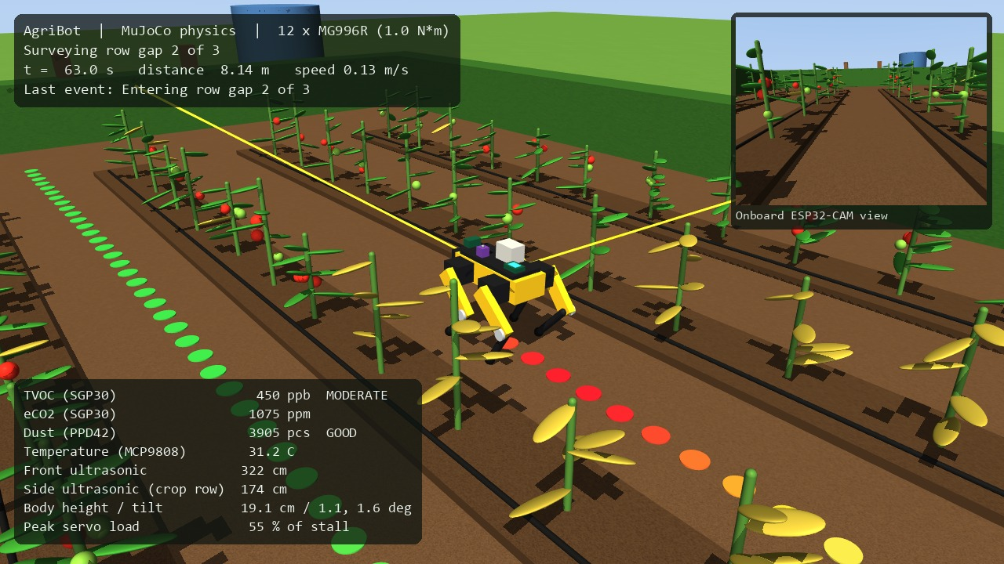
MuJoCo Physics Simulation
Robot from measured geometry: 140 × 78 mm hips, 111 / 125 mm legs, 1.35 kg
12 position servos capped at 1.0 N·m (MG996R stall 0.92–1.08 N·m)
Leg IK checked against MuJoCo's own kinematics: 1,280 targets, 0.0000 mm error
Mission: stand up, trot each row gap, detect row ends by ultrasonic, turn, log gas, dust and temperature
Surveying the middle row gap; the trail turns red over the diseased plants
Notes:
Built from scratch in MuJoCo after Gazebo would not hold a stance. The robot is built from measured dimensions and its servos are capped at MG996R stall torque, so if it walks here, it is not because of unrealistic motors.

Slide 13
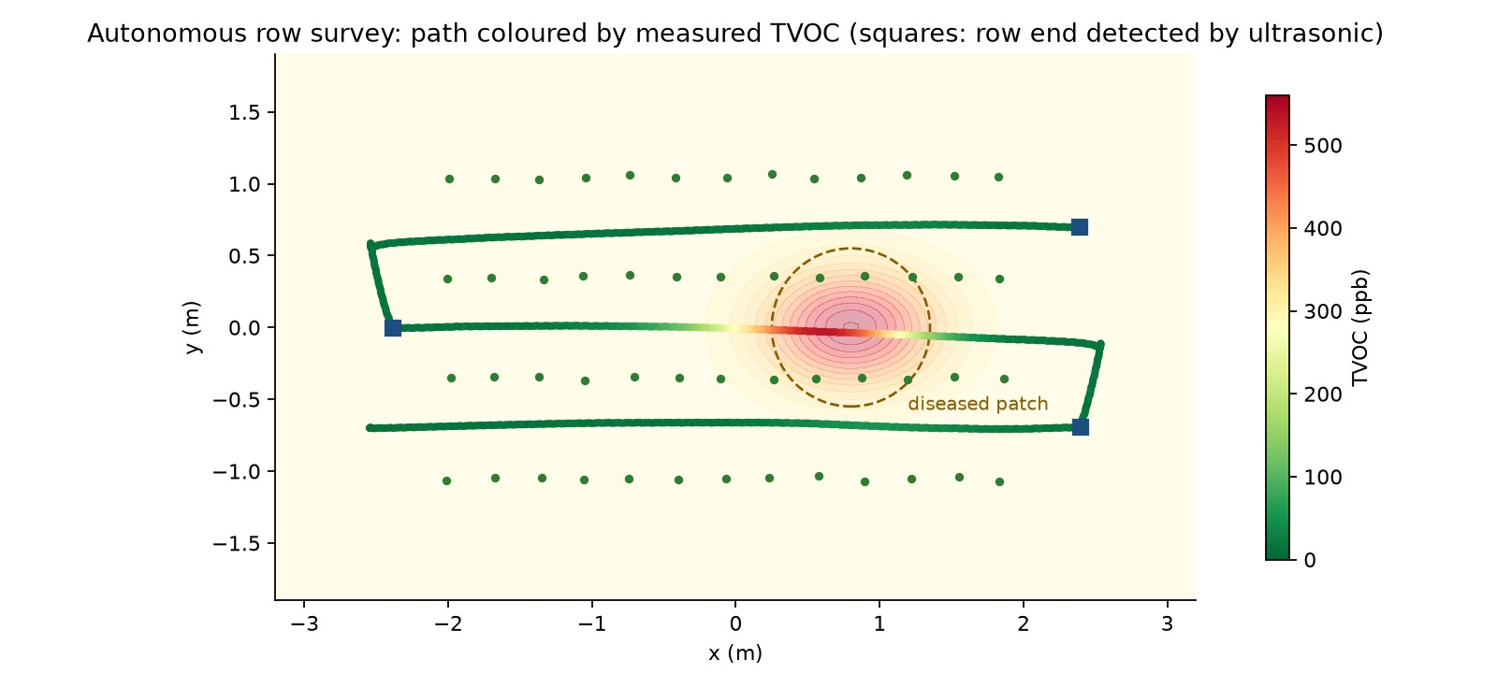
Results — Autonomous Field Survey
16.7 m · 129 s
all 3 row gaps surveyed, no falls
3 / 3
row ends detected by the front ultrasonic
≤ 2.7°
body tilt throughout; servos at their limit 1.3 % of the time
Path coloured by measured TVOC; squares mark row ends detected by the front ultrasonic
535 ppb
TVOC peak, 0.2 m from the true source (SGP30 lag)
Notes:
The full survey ran without a fall. The TVOC peak sits 0.2 m from the true source because the SGP30 takes about 2.5 s to respond while the robot keeps walking; a real effect worth discussing.

Slide 14
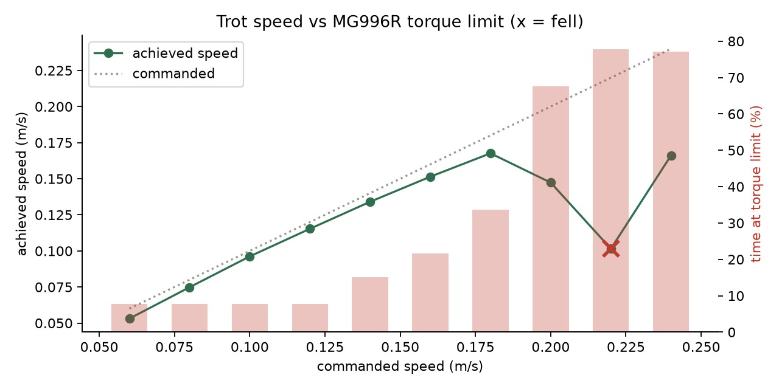
Engineering Findings
Centre of mass sits 12 mm aft
All four knees point backward, as on SpotMicro, so the leg mass hangs rearward.
With footholds centred on the body, the trot tipped backward within 1–3 s in all 24 gait settings tried.
Placing the feet around the measured centre of mass made it stable: 0.7° tilt trotting in place. The same correction applies to the physical robot.
Speed | Result
0.08–0.18 m/s | Tracks the command within 7 %
0.20 m/s | Servos at limit 68 % of the time, tilt 12°
0.22 m/s | Falls
Notes:
Two findings that change the physical build. First, the centre-of-mass offset: without correcting it the robot fell in all 24 gait settings. Second, MG996R torque sets a speed ceiling of about 0.18 m/s.

Slide 15
Limitations
Limitation | Effect | How it is handled
Simulated gas, dust and temperature come from modelled fields | Simulation shows the method, not field data | Hardware sensors validated on the bench; field logging next
Classifier trained on lab photos (PlantVillage), 14 crops | Lower accuracy on real field images | Leaf check and 50 % confidence threshold; field-image fine-tuning as future work
SGP30 eCO₂ is estimated from VOCs; PPD42 counts particles, not PM2.5 | Relative readings, not regulatory values | Used for trends and alerts, not absolute limits
Walking not yet shown on hardware; MG996R margins are thin | Locomotion evidence is simulation-only | Servo MVP before the final review, with the CoM correction ready
Dust and ultrasonic sensors not yet wired | Not part of today's live demo | Firmware complete and uploaded; wiring next
Notes:
State these before the panel asks. Each one is also listed in the repository README.

Slide 16
Remaining Work Before the Final Review
01
Wire the PPD42 and both HC-SR04s through their dividers; firmware already handles them
Deliverables
Project report in the BCSE497J template, with similarity ≤ 15 %, by 21 October
Journal / conference paper submission with acknowledgement
Final panel review demonstration
02
Grove Relay v1.3: act on readings (irrigation pump or gas alert), with a dashboard control
03
Servo MVP: stand, sit and step, using the simulator's gait and centre-of-mass correction
Notes:
Everything on the left is firmware-ready or a direct continuation; the deliverables on the right have fixed deadlines.

Slide 17
Technology Stack
Hardware
Firmware
Dashboard & AI
Seeed XIAO ESP32-S3 + expansion board · ESP32-CAM (OV3660) + MB · SGP30, MCP9808, PPD42, HC-SR04 × 2 · 12 × MG996R
Arduino-ESP32 3.3 · Adafruit SGP30 · U8g2 · esp_http_server (MJPEG)
Python · Flask · PyTorch · Hugging Face Transformers · MobileNetV2 (PlantVillage)
Simulation
Mechanical
Collaboration
MuJoCo 3 · NumPy · Matplotlib · headless video and metrics
SpotMicro base (CC-BY) · PLA+ / TPU · parametric Python generators for the custom parts
Git + GitHub: firmware, dashboard, simulation, print files and results in one repository
Notes:
Everything here is in the public GitHub repository, with run instructions.

Slide 18
Literature Review (18 Papers)
# | Authors & Year | Paper Title | Venue | Key Contribution | Research Gap
1 | Bledt et al. (2018) | MIT Cheetah 3: Design and Control of a Robust, Dynamic Quadruped Robot | IEEE/RSJ IROS | Designed high-torque density proprioceptive actuators and Model Predictive Control (MPC) for dynamic walking over rough terrain without vision. | High cost (~$50k+), complex custom planetary gearing, no environmental/agricultural sensing payload.
2 | Kau et al. (2019) | Stanford Doggo: An Open-Source, Quasi-Direct-Drive Quadruped | IEEE ICRA | Developed an open-source 3D-printed quadruped platform using quasi-direct drive brushless motors for dynamic bounding. | Optimized purely for acrobatic jumps/speed; lacks on-board compute for perception and has <10 min battery life.
3 | Katz et al. (2019) | Mini Cheetah: A Hardware Design for Extremity Locomotion | IEEE ICRA | Modular 3-DOF leg design using low-cost backdrivable BLDC motors enabling agile omnidirectional gaits. | Focuses strictly on mechanical agility in laboratory environments; no autonomous navigation or edge AI pipeline.
4 | Hutter et al. (2016) | ANYmal - A Unique Quadruped Robot for Autonomous Operation in Harsh Environments | IEEE/RSJ IROS | Industrial-grade quadruped with series elastic actuators (SEAs) and IP67 ruggedized body for outdoor inspection. | Prohibitively expensive ($100k+), heavy industrial form-factor unsuitable for smallholder precision farming.
5 | Ding et al. (2021) | Learning to Walk on Uneven Terrain for Quadrupedal Robots using Reinforcement Learning | IEEE Transactions on Robotics (T-RO) | Trained neural network locomotion policies in simulation (Isaac Gym) with robust sim-to-real transfer over rugged slopes. | High computational training overhead; policy does not integrate multi-sensor agronomic payloads or path tracking.
Notes:
Carried over from Review III. Summarise the gap: no low-cost legged platform combines in-field environmental sensing with plant-disease detection.

Slide 19
Literature Review (18 Papers)
# | Authors & Year | Paper Title | Venue | Key Contribution | Research Gap
6 | Bellicoso et al. (2018) | Dynamic Locomotion Through Online Nonlinear Model Predictive Control for Quadrupedal Robots | IEEE Robotics & Automation Letters (RA-L) | Real-time ZMP and CoM trajectory optimization enabling adaptive crawl and trot gaits over unmodeled obstacles. | Requires high-end x86 computer boards; difficult to run concurrently with edge vision models on low-power platforms.
7 | Fehlmann et al. (2023) | Precision Agriculture Using Autonomous Ground Robots: A Review | Springer Precision Agriculture | Systematic review of wheeled and tracked agricultural rovers for weed control, phenotyping, and soil sampling. | Identifies severe mobility failure of wheeled rovers in wet mud, soft soil, and high-crop canopy furrows.
8 | Roldán et al. (2018) | Mini-UAVs and Mobile Robots for Precision Agriculture: A Review of Multi-Robot Systems | Computers and Electronics in Agriculture (Elsevier) | Analyzed complementary roles of aerial drones (macro-surveys) and ground robots (micro-inspection). | Highlighted drone limitations: 20-min flight time, inability to inspect leaf undersides, and blind spots beneath crop canopies.
9 | Bogue, R. (2016) | Robots in Agriculture: State of the Art and Future Directions | Industrial Robot: An International Journal | Surveyed commercial adoption of agricultural robotics, highlighting high ROI in crop health monitoring. | Commercial units are bulky, heavy, cause soil compaction, and require flat structured greenhouse tracks.
10 | Vasconez et al. (2020) | Human–Robot Interaction in Agriculture: A Survey and Review | Computers and Electronics in Agriculture (Elsevier) | Investigated telemetry, UX dashboards, and safety mechanisms for farmer-robot interfaces in open fields. | Found most agricultural robotic interfaces are academic prototypes lacking real-time edge telemetry and alert maps.

Slide 20
Literature Review (18 Papers)
# | Authors & Year | Paper Title | Venue | Key Contribution | Research Gap
11 | Mohanty et al. (2016) | Using Deep Learning for Image-Based Plant Disease Detection | Frontiers in Plant Science | Trained AlexNet and GoogLeNet on 54,306 images across 26 diseases with 99.35% classification accuracy. | Tested only on static laboratory-controlled leaf images with uniform backgrounds; lacks edge device deployment.
12 | Ferentinos, K. P. (2018) | Deep Learning Models for Plant Disease Detection and Diagnosis | Computers and Electronics in Agriculture (Elsevier) | Evaluated VGG, ResNet, and AlexNet on 87,848 leaf images with real-world noise variations (99.5% accuracy). | High parameter count (VGG/ResNet) causes severe latency and memory bottlenecks on embedded single-board computers.
13 | Too et al. (2019) | A Comparative Study of Fine-Tuning Deep Learning Architectures for Plant Disease Identification | Computers and Electronics in Agriculture (Elsevier) | Benchmarked MobileNetV2, DenseNet-121, and InceptionV3; proved MobileNetV2 achieves 97.4% accuracy with 10× fewer FLOPs. | Did not perform hardware-specific quantization (TensorRT / ONNX) or test real-time video stream ingestion.
14 | Chen et al. (2020) | Using Deep Transfer Learning for Image-Based Plant Disease Identification on Embedded Devices | Computers and Electronics in Agriculture (Elsevier) | Deployed lightweight CNN on Raspberry Pi 3B+ using INT8 quantization, achieving 12 FPS at 92.1% accuracy. | Insufficient FPS for continuous mobile robot navigation; no integration with robotic gait or sensor fusion.
15 | Saleem et al. (2019) | Plant Disease Detection and Classification by Deep Learning: A Review | Computers and Electronics in Agriculture (Elsevier) | Comprehensive meta-analysis of deep learning architectures, dataset biases, and real-time field challenges. | Concluded that field-ready solutions require mobile ground robots that bring cameras within 0.5m of plant leaves.

Slide 21
Literature Review (18 Papers)
# | Authors & Year | Paper Title | Venue | Key Contribution | Research Gap
16 | Ray, P. P. (2017) | Internet of Things for Smart Agriculture: Technologies, Practices and Future Direction | Journal of Ambient Intelligence and Smart Environments | Proposed layered IoT architecture for soil moisture, microclimate, and particulate monitoring in precision farming. | Relied exclusively on stationary sensor nodes (motes), creating spatial coverage gaps across large farm tracts.
17 | Elijah et al. (2018) | An Overview of Internet of Things (IoT) and Data Analytics in Smart Agriculture | IEEE Internet of Things Journal | Investigated wireless sensor networks (WSNs) and cloud data pipelines for environmental anomaly detection. | High infrastructure cost of deploying hundreds of stationary nodes; vulnerable to field vandalism and weather damage.
18 | Bacco et al. (2019) | Smart Farming: Technologies, Applications and Challenges in Precision Agriculture | Computers and Electronics in Agriculture (Elsevier) | Explored multi-sensor data fusion (temperature, humidity, organic gases, optical imagery) for soil health profiling. | Lacked mobile autonomous platforms to transport multi-sensor payloads dynamically throughout crop rows.

Slide 22
References
[1] Bledt, G., et al. (2018). MIT Cheetah 3: Design and Control of a Robust, Dynamic Quadruped Robot. IEEE/RSJ IROS. DOI: 10.1109/IROS.2018.8593885
[2] Kau, N., et al. (2019). Stanford Doggo: An Open-Source, Quasi-Direct-Drive Quadruped. IEEE ICRA. DOI: 10.1109/ICRA.2019.8794436
[3] Katz, B., et al. (2019). Mini Cheetah: A Hardware Design for Extremity Locomotion. IEEE ICRA. DOI: 10.1109/ICRA.2019.8793865
[4] Hutter, M., et al. (2016). ANYmal — A Unique Quadruped Robot for Autonomous Operation. IEEE/RSJ IROS. DOI: 10.1109/IROS.2016.7758092
[5] Ding, Z., et al. (2021). Learning to Walk on Uneven Terrain for Quadrupedal Robots using RL. IEEE Transactions on Robotics, 37(4), 1120–1134.
[6] Bellicoso, C. D., et al. (2018). Dynamic Locomotion Through Online Nonlinear MPC for Quadrupedal Robots. IEEE Robotics and Automation Letters, 3(4). DOI: 10.1109/LRA.2018.2848303
[7] Fehlmann, S., et al. (2023). Precision Agriculture Using Autonomous Ground Robots: A Review. Springer Precision Agriculture, 24(2), 520–549.
[8] Roldán, J. J., et al. (2018). Robots in Agriculture: State of the Art and Future Directions. Computers and Electronics in Agriculture, 146, 76–89.
[9] Bogue, R. (2016). Robots in Agriculture: State of the Art and Future Directions. Industrial Robot, 43(1), 1–6.
[10] Vasconez, J. P., et al. (2020). Human–Robot Interaction in Agriculture: A Survey and Review. Computers and Electronics in Agriculture, 175, 105500.
[11] Mohanty, S. P., et al. (2016). Using Deep Learning for Image-Based Plant Disease Detection. Frontiers in Plant Science, 7, 1419. DOI: 10.3389/fpls.2016.01419
[12] Ferentinos, K. P. (2018). Deep Learning Models for Plant Disease Detection and Diagnosis. Computers and Electronics in Agriculture, 145, 311–318.
[13] Too, E. C., et al. (2019). A Comparative Study of Fine-Tuning Deep Learning Architectures for Plant Disease Identification. Computers and Electronics in Agriculture, 161, 272–279.
[14] Chen, J., et al. (2020). Using Deep Transfer Learning for Image-Based Plant Disease Identification on Embedded Devices. Computers and Electronics in Agriculture, 176, 105653.
[15] Saleem, M. H., et al. (2019). Plant Disease Detection and Classification by Deep Learning: A Review. Computers and Electronics in Agriculture, 164, 104902.
[16] Ray, P. P. (2017). Internet of Things for Smart Agriculture: Technologies, Practices and Future Direction. Journal of Ambient Intelligence and Smart Environments, 9(4), 395–420.
[17] Elijah, O., et al. (2018). An Overview of Internet of Things (IoT) and Data Analytics in Smart Agriculture. IEEE Internet of Things Journal, 5(5), 3758–3773.
[18] Bacco, M., et al. (2019). Smart Farming: Technologies, Applications and Challenges. Computers and Electronics in Agriculture, 164, 104908.

Slide 23
Conclusion
The sensing payload works end to end: two wireless nodes, a live dashboard, logging, and leaf-disease classification that refuses to guess without a leaf.
Locomotion is validated in physics simulation with real servo limits: a full autonomous row survey without a fall.
Simulation produced two findings for the physical build: centre-of-mass-centred footholds, and a ~0.18 m/s speed ceiling for MG996R servos.
Repository github.com/AdithyaSM31/Precision-Agriculture-Monitoring-Quadruped-Robot-Dog
Thank you
Notes:
Close on what is demonstrable today, then move to the live demo: dashboard, breath test, room scan rejected, leaf scan diagnosed, and the simulation.

